Slide 1
Dynamic COVID Community Vulnerability Index(DCCVI) and Hospital Utilization Forecast
Ashkan Farahani

Slide 2
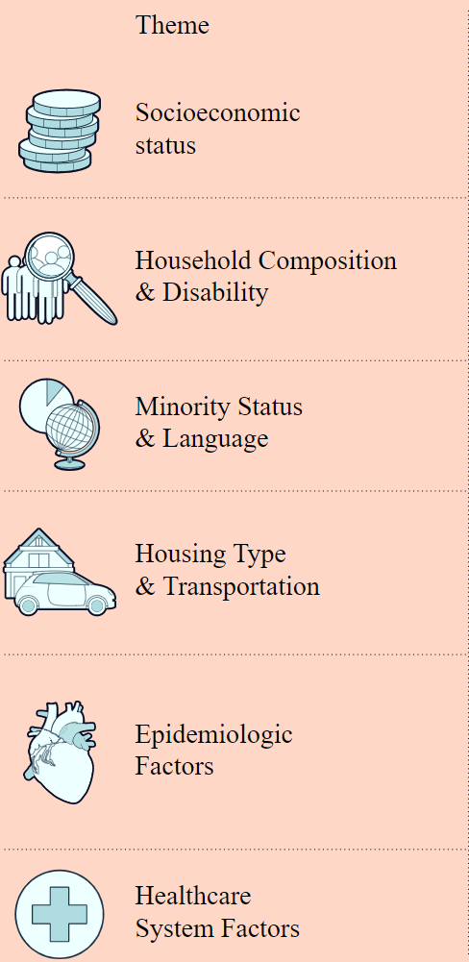
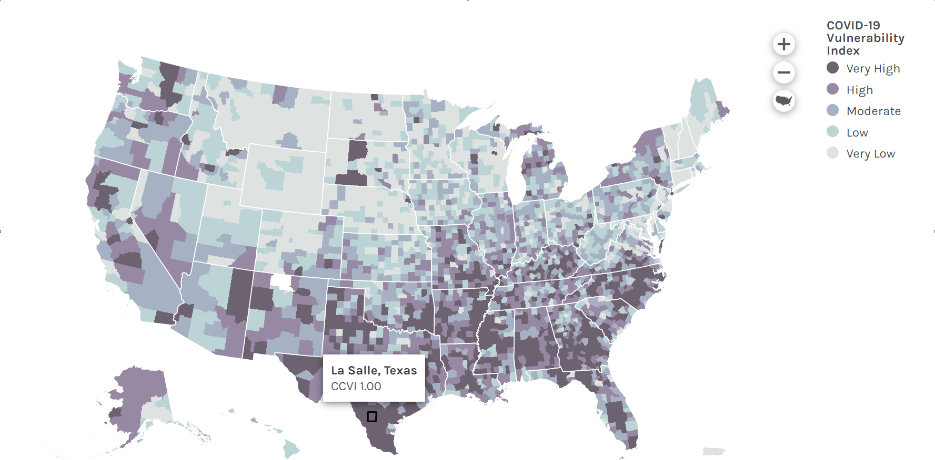
Static COVID Community Vulnerability Index (CCVI) at the county level
Social Vulnerability Index (SVI)
CCVI
Hospital Beds per 100,000 Fixed
Intensive Care Unit (ICU) Beds per 100,000

Slide 3
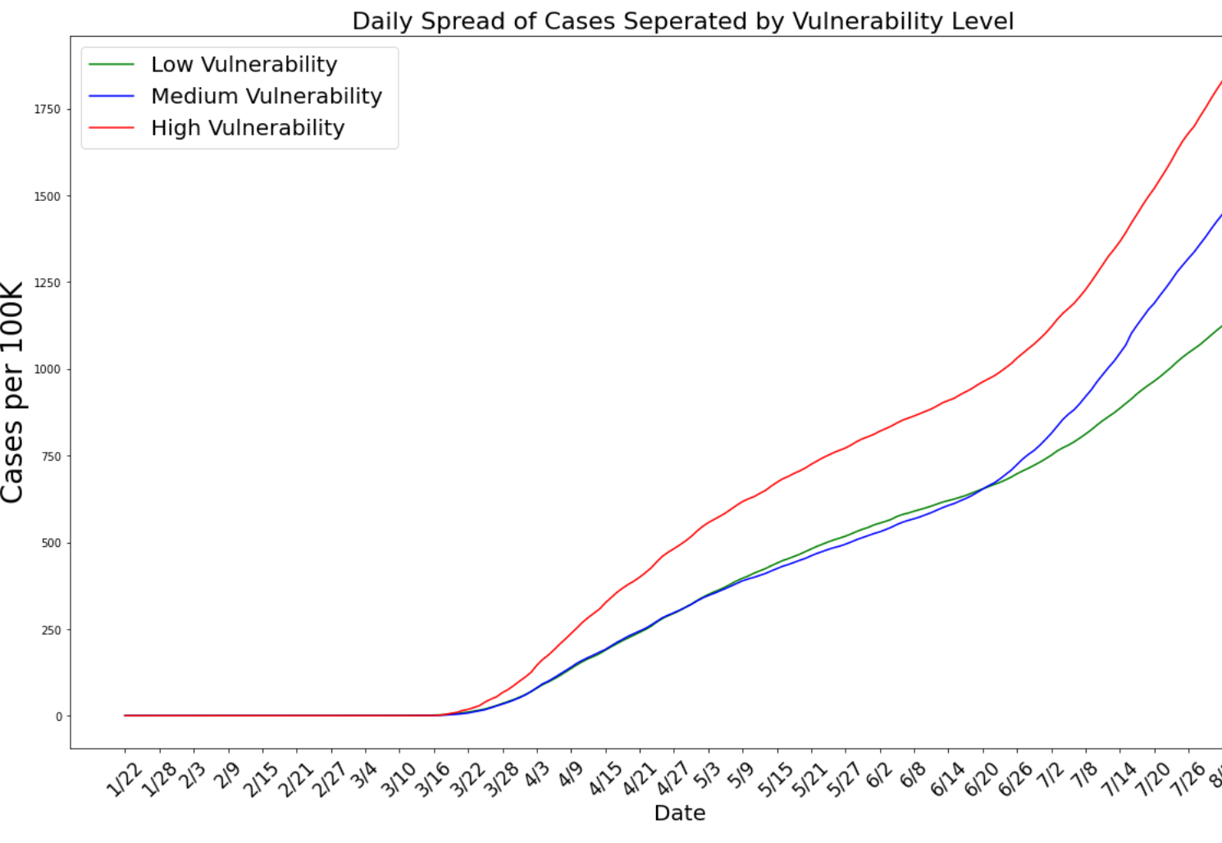
Spread of Cases at Vulnerable Level
Cases are growing faster in vulnerable highly vulnerable counties
Vulnerable counties are more likely short on health system capacity
Solution:
Forecasting Health system capacity for the next 4 weeks
Hospital bed utilization
ICU beds Utilization
Controlled Ventilation Utilization

Slide 4
Data Product: Dynamic CCVI
Dynamic CCVI
Controlled Ventilation Utilization Prediction
ICU beds Utilization Prediction
Hospital bed utilization prediction
Fixed CCVI
End User
Health System Decision Makers at County Level

Slide 5
Approach
Cases Prediction
Hospitalization Prediction
Baseline hospitalization utilization for non-COVID patients
Compartment Epidemic Models
Different Versions are developed for COVID and established by CDC for competition
Machine Learning Approach: Multi-model Ensemble approach out of available models
Use demographic and epidemiological factors to predict hospitalization

Slide 6
Input Data Resources
Cases Prediction
Hospitalization Prediction
USA Hospital Beds - Definitive Healthcare
Hospitalization Surveillance Network (COVID-NET) by CDC
Modeling Groups identified by CDC forecast tracking
The COVID TRACKING PROJECT – COVID HOSPITALIUZATION DATA
Johns Hopkins Coronavirus Resource Center
ICU beds - Kaiser Health News, Centers for Medicare, & Medicaid Services (CMS)
The Agency for Healthcare Research and Quality (AHRQ)
Change Healthcare - 2020 COVID-19 Claims
Gallup poll – Adults Divided on Status of COVID-19 Situation
Hospital Capacity
Current COVID Hospitalization
Demographic and epidemiological risk factors in COVID hospitalization

Slide 7
How Dynamic CCVI is different?
Cases Prediction
Hospitalization Prediction
Do not assume fixed hospitalization rate out of new cases
Single epidemiology models suffer faster with their assumptions
Use of Multi-model Ensemble approach can provide a more consistent prediction under different scenarios
Use of epidemiological risk factors ( e.g. Age, health conditions – immune-compromised) for more accurate estimation of the kind and rate of hospitalization rate in each county.

Slide 8
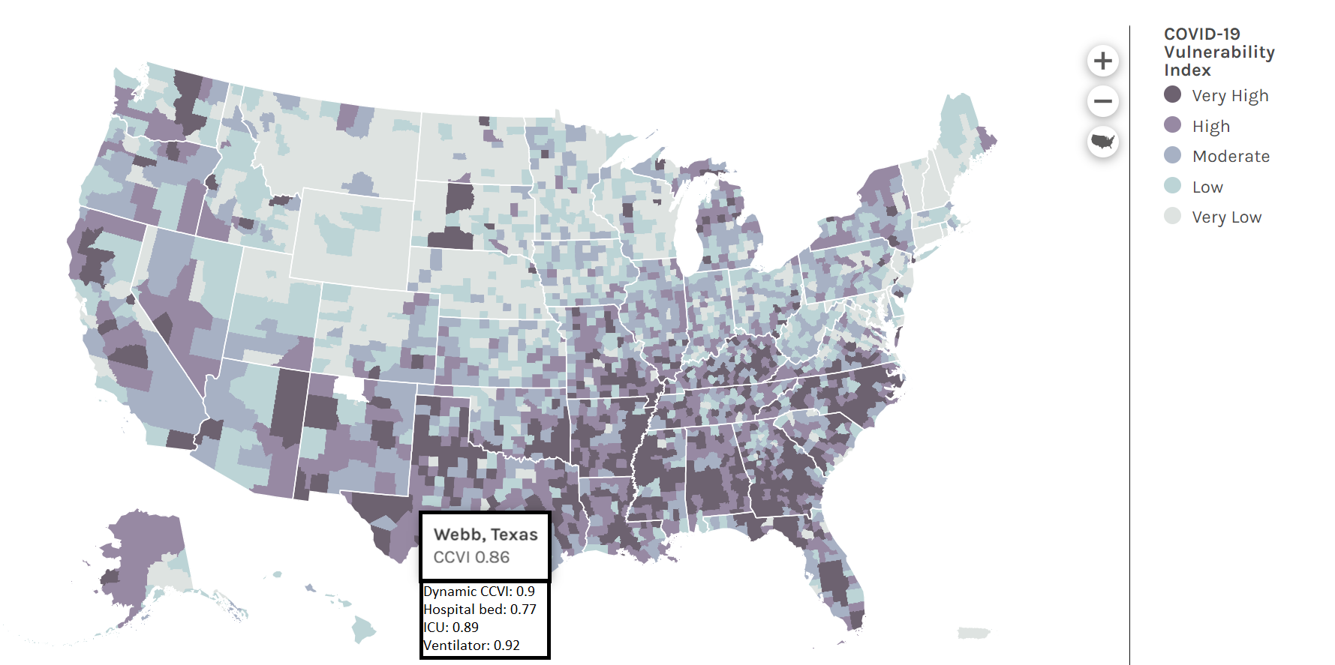
Dynamic CCVI Dashboard

Slide 9
Questions?

